Slide 1

1888

Slide 2
Summary
HISTORY
What is the context ?
Where does he appear ?lieuB
CIVIL
What does the press said on about him ?
Where does he appear ? (cinema,book)B
POLICE
What is scotland yard ?
What are the hypotesis about him ?
Who are the suspects ?B
Who are the victims ?B
CONCLUSION

Slide 3


Slide 4

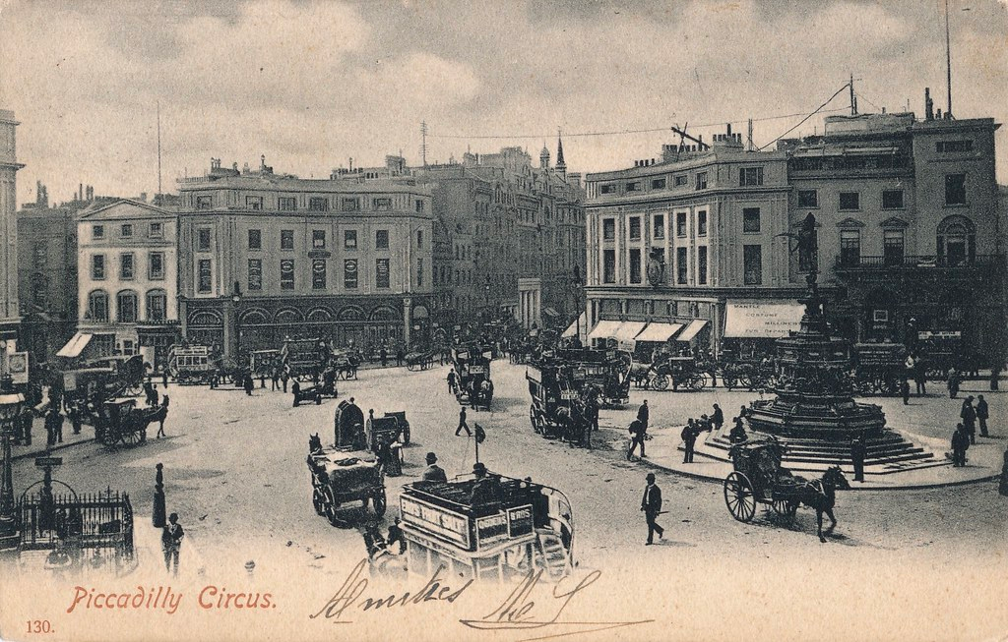
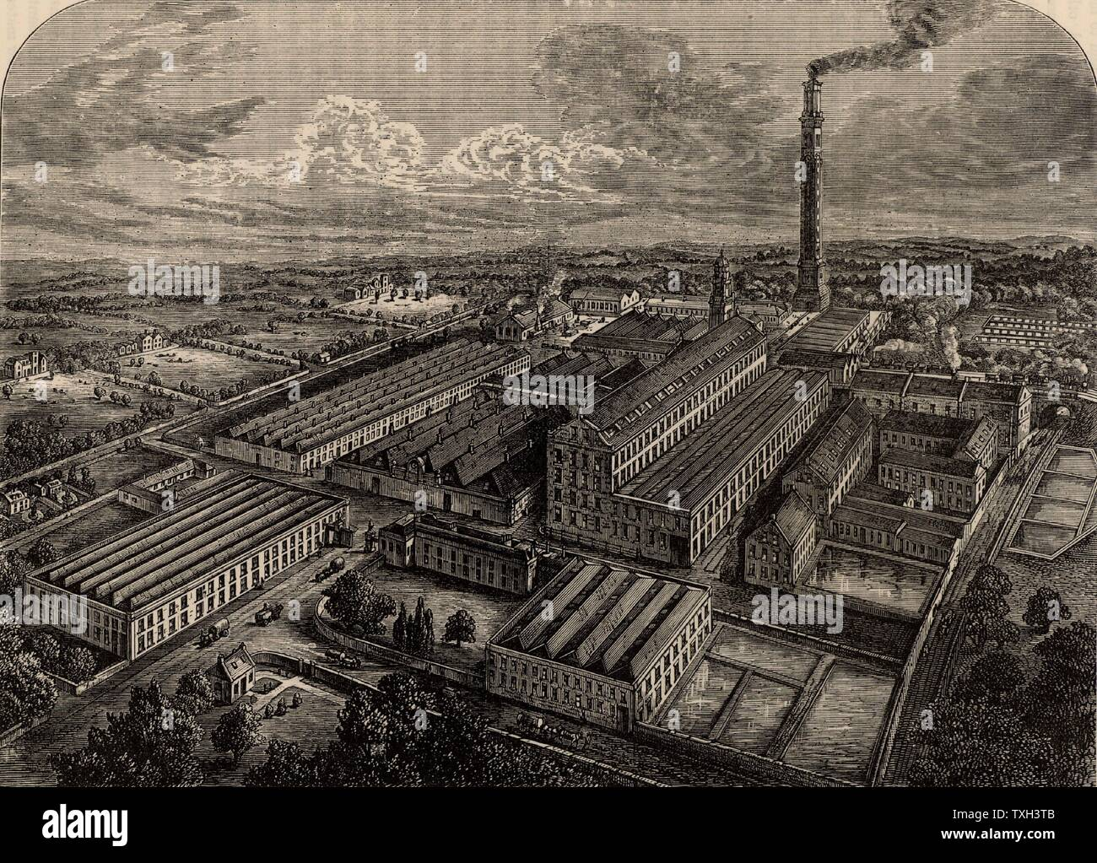
The murders took place in the 19 siecle when united kingdom was the first world power .
The queen was victoria (1837-1901). United kingdom had the biggest colonial empire
London is the most populated city and the biggest metropol and more and more immigrant come to london(jewish(voc) and irish)
Those immigrants lived in poor district (like whitechapel) where insecurity reigned.
There were also factory inside london.

Slide 5
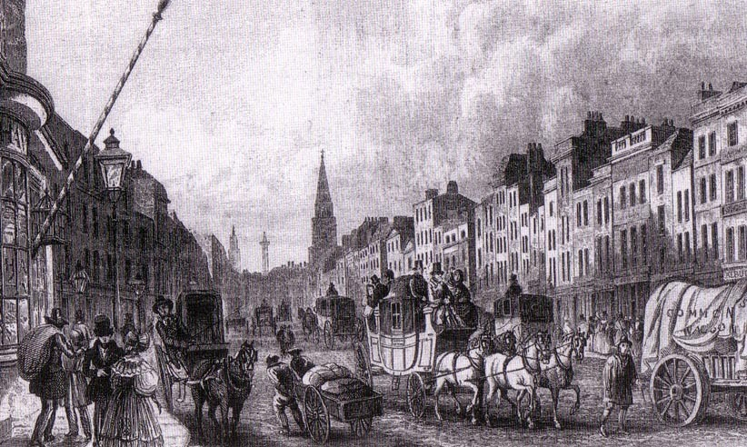
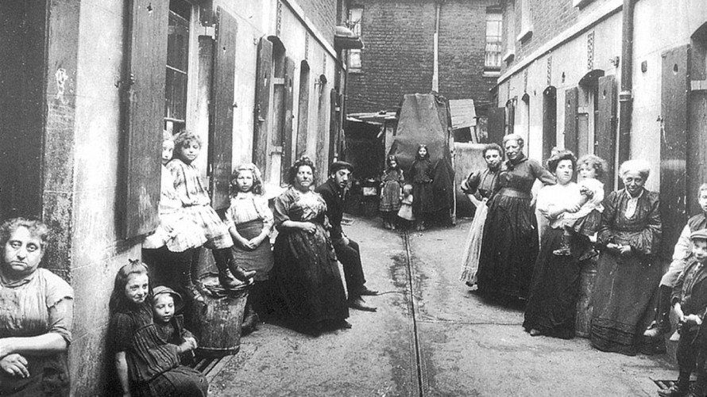
Jack the ripper, and his murders happened in london,between 1888 and 1892 (look what is the context ) in whitechapel district.
Whitechapel is a district really poor where there were a lot of pubs and drunkard(voc), there were also factory who transformed the district’s air into a black cloud(voc)

Slide 6


Slide 7


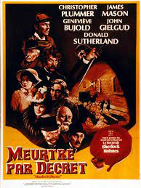
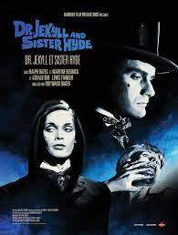
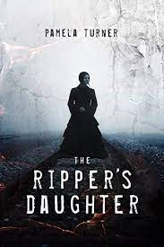
Jack the Ripper appears in many films , the favorites of an internet user are :
-« Meurtre par décret » (1979) produce by Bob Clark in France.
-“DrJekyll et Sister Hyde”(1971)produce by Roy Ward Baker in France.
-« Jack the ripper’s daughter »(1971)by Peter Sasdy Jack the

Slide 8
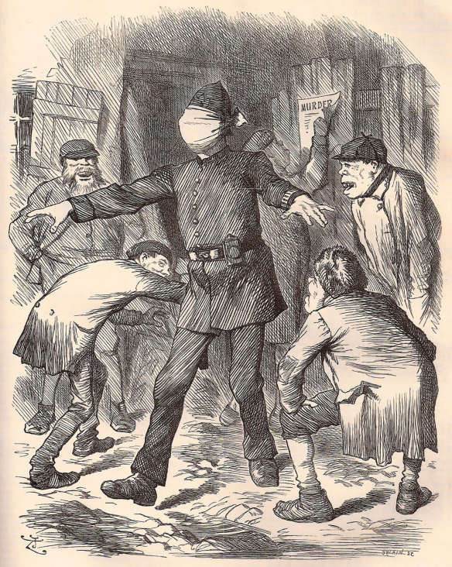
-The newspapers were very cheap and the press’companies saw « Jack the Ripper » like an box of money Jack the ripper understood that the press is very important so, he will send 3 letters to the press
-160 describe his murders the quenne herself was worried
The press and people laughed the police who can’t found Jack .

Slide 9
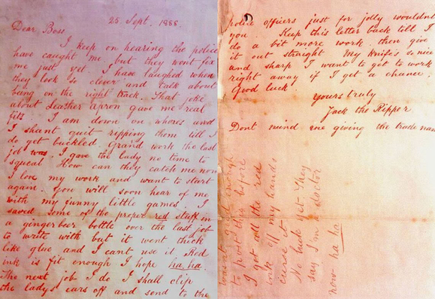

Slide 10
POLICE

Slide 11
First the police did not care about this murders because the victims were prostitutes but he was a serial killer.
Scotland Yard will questionned 2000 person
One doctor did the « psychological profile of Jack the ripper » for him Jack
For the society Jack, a serial killer can’t be an English, a gentleman so it was, for sure, an immigrant (like Jewish and Irish)

Slide 12

At least 100 suspects but none have been accepted. there were eight main suspects, they are
Prince Albert Victor of Wales, heir to the crown of Great Britain,
the doctor and surgeon Sir William Gull,
the painter and artist Walter Sickert,
James Maybrick,
Sir Leslie Melville Macnaghten,
Francis J. Tumblety and
The Tenant (Wentworth Bell Smith) and Aaron Kosminski (he is the one of the most suspected). They all have been the subject of books and adaptations.

Slide 13

-There were five victims assigned to Jack the ripper :Mary Ann Nichols, Annie Chapman, Elizabeth Stride, Catherine Eddowes, and Mary Jane Kelly
-31 august 1888, Mary Ann Nichols a prostitute was killed in whitechapel crime scnene : disembowel by knife and her vagina have been cut
-7 june 1888 Annie Chapman a prostitute was killed in the same condition
30 september 1888 Elizabeth Stride and Catherine Eddowes faces have been cut like the nose the ears etc..
-5 november 1888 Mary Jane Kelly was killed still disembowel etc...but they were 2 differences : she was only 25 (the other were 40) and she was killed in his house

Slide 14

During the 19 century when the UK was one of the biggest empire
In a poor distrct whitechapel where reigns the insecurity
Jack ripper’murders really existed but the character maybe not he killed 5 women
His murders were horrible
The queen herself was worried and asked to the police to hurry up the investigation
Scotland yard questionned more than 2000 person
More than 160 newspaper’companies describe his murders

